Slide 1

Welcome to
Our Sunday School
We’ll start at 9:07
visit OurSundaySchool.com for more about our class

Slide 2
Ephesians, week 4 (pages 23–27)

Slide 3

Visitors: loan you
a copy for today
Members: get a
print edition
Online: visit OurSundaySchool.com

Slide 4
Hear: Ephesians 1

Slide 5
Ephesians 1:1–2
Paul, an apostle of Christ Jesus by the will of God,
To the saints who are at Ephesus and who are faithful in Christ Jesus: Grace to you and peace from God our Father and the Lord Jesus Christ.

Slide 6
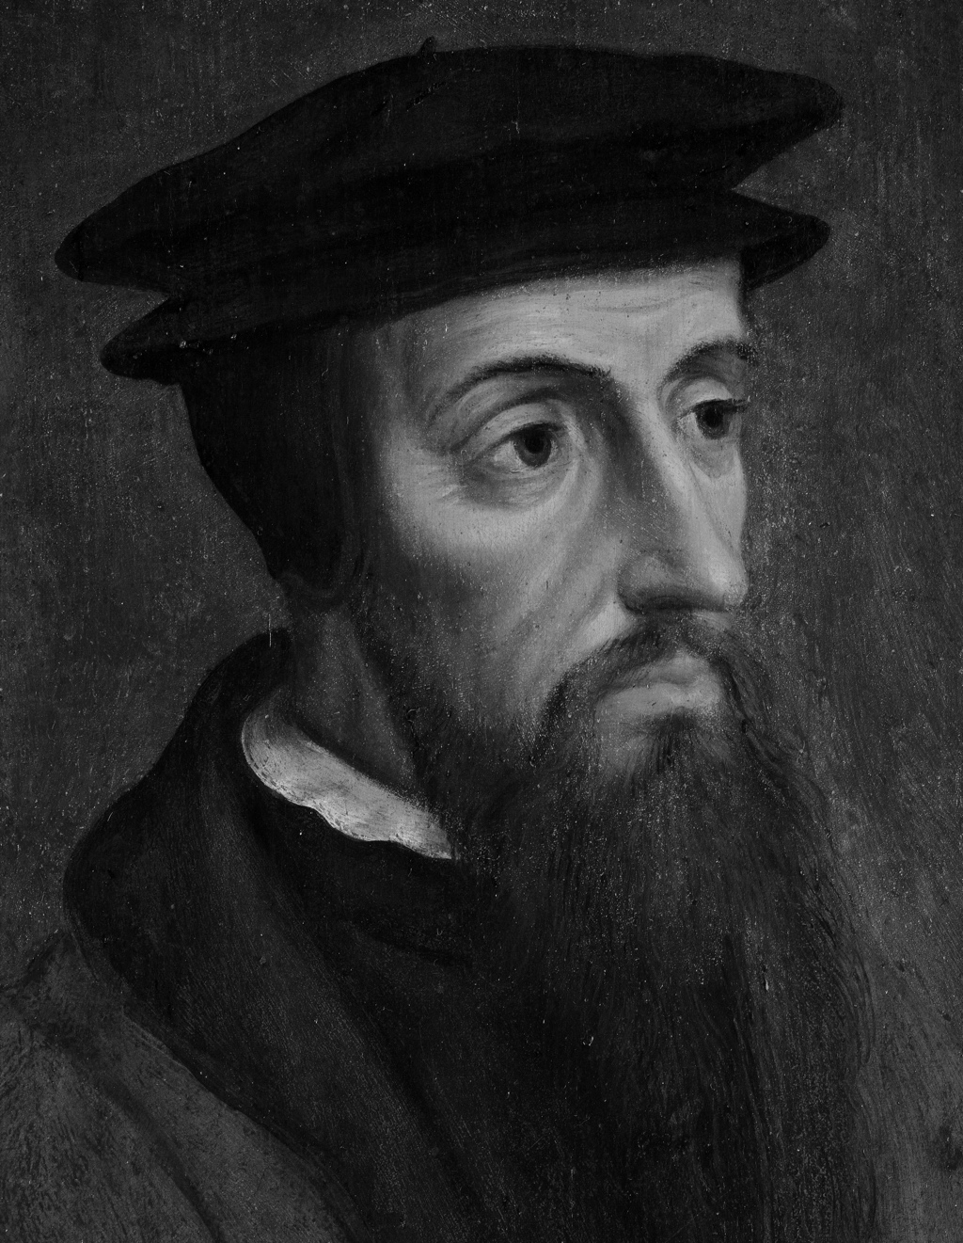
Dr. John Calvin
All believers are saints, and every saint is a believer

Slide 7
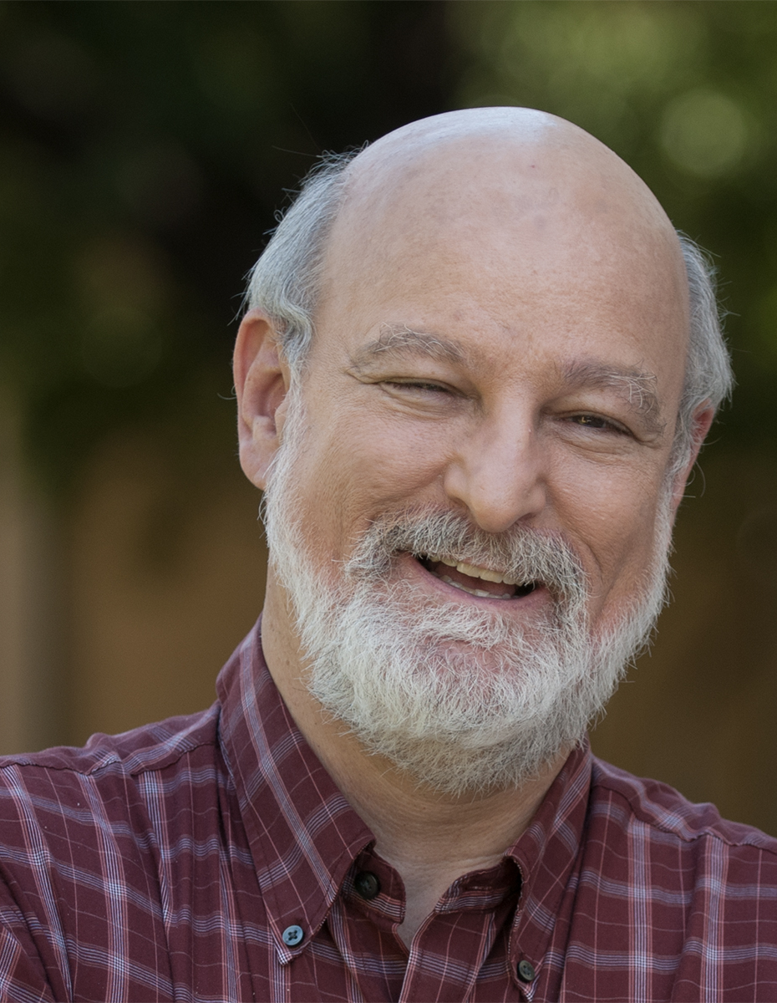
Dr. Darrell Bock
In the Old Testament, a variety of items were described as set apart: a nation, a specific place, the temple, the Sabbath, as well as people

Slide 8

Dr. Bill Klein
Yahweh himself was the “Holy One of Israel”
(Isaiah 45:11)

Slide 9
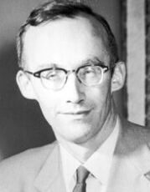
Dr. Markus Barth
In the Greek translation of the OT, the congregation assembled for worship, the whole people of Israel, and sometimes also the angels are called “saints.”…

Slide 10
Dr. Markus Barth
By using the same designation in 1:1, the author of Ephesians bestows upon all his pagan-born readers a privilege formerly reserved for Israel

Slide 11
Ephesians, week 4 (pages 23–27)

Slide 12
Review: Excursus: Bible translations

Slide 13
Footnotes in the LSB (numbers)
Lit through
Or holy ones
Three early mss omit at Ephesus

Slide 14
“in Ephesus” options
“in Ephesus” present
“in Ephesus” not present

Slide 15
Review: Excursus: Bible translations
Autographs (one per book)

Slide 16
Review: Excursus: Bible translations
Autographs (one per book)

Slide 17
Review: Excursus: Bible translations
Autographs (one per book)
Copies (many per book)

Slide 18
Review: Excursus: Bible translations
Autographs (one per book)
Copies (many per book)

Slide 19
Review: Excursus: Bible translations
Autographs (one per book)
Copies (many per book)
Variants (copy errors—intentional or not)

Slide 20
Review: Excursus: Bible translations
Autographs (one per book)
Copies (many per book)
Variants (copy errors—intentional or not)

Slide 21
Review: Excursus: Bible translations
Autographs (one per book)
Copies (many per book)
Variants (copy errors—intentional or not)
Families (communities of error)

Slide 22
Review: Excursus: Bible translations
Autographs (one per book)
Copies (many per book)
Variants (copy errors—intentional or not)
Families (communities of error)

Slide 23
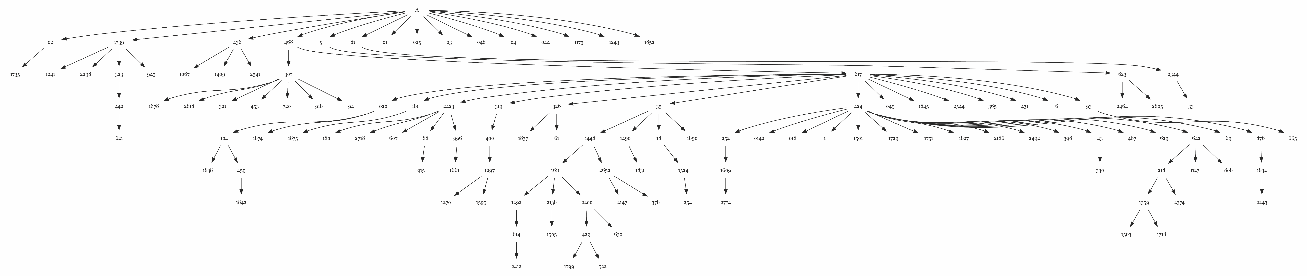
The predominant textual flow diagram for non-fragmentary witnesses in the Catholic Epistles; image source: Peter J. Gurry, A Critical Examination of the Coherence-Based Genealogical Method in New Testament Textual Criticism (Brill, 2017), pp. 60-61

Slide 24
Major Greek New Testament families
Western (Syrian) | Byzantine | Alexandrian
From north Africa to Italy; Gaul to Syria | From Constantinople; Byzantine Empire | From Alexandria
3rd – 9th centuries | 5th – 16th centuries | 2nd – 4th centuries
Western Church | Eastern Church; Textus Receptus | Codex Vaticanus, Codex Sinaiticus
Pre-1520 | 1520-1900 | 1900→
Wycliffe, Douay-Rheims (original) | KJV, NKJV, Tyndale, Coverdale, Geneva | NIV, ESV, CSB, NASB, LSB
From Wikipedia’s article on Textual Criticism

Slide 25
Review: Excursus: Bible translations
Autographs (one per book)
Copies (many per book)
Variants (copy errors—intentional or not)
Families (communities of error)
Textual criticism (identifying autographs)

Slide 26
Review: Excursus: Bible translations
Autographs (one per book)
Copies (many per book)
Variants (copy errors—intentional or not)
Families (communities of error)
Textual criticism (identifying autographs)

Slide 27
Textual criticism recommended reading
Wikipedia’s article on textual criticism

Slide 28
Review: Excursus: Bible translations
Autographs (one per book)
Copies (many per book)
Variants (copy errors—intentional or not)
Families (communities of error)
Textual criticism (identifying autographs)
Critical edition (closest to the autograph)

Slide 29
Review: Excursus: Bible translations
Autographs (one per book)
Copies (many per book)
Variants (copy errors—intentional or not)
Families (communities of error)
Textual criticism (identifying autographs)
Critical edition (closest to the autograph)

Slide 30
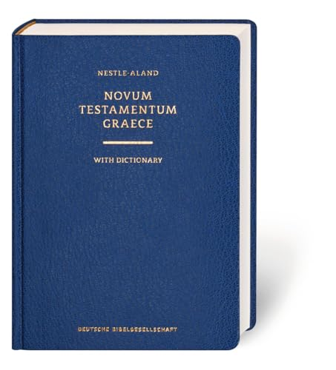

Slide 31
Ephesians 1:1–2 (NA28)
Παῦλος ἀπόστολος Χριστοῦ Ἰησοῦ διὰ θελήματος θεοῦ τοῖς ἁγίοις τοῖς οὖσιν
[ἐν Ἐφέσῳ] καὶ πιστοῖς ἐν Χριστῷ Ἰησοῦ, χάρις ὑμῖν καὶ εἰρήνη ἀπὸ θεοῦ πατρὸς ἡμῶν καὶ κυρίου Ἰησοῦ Χριστοῦ.

Slide 33
Review: Excursus: Bible translations
Autographs (one per book)
Copies (many per book)
Variants (copy errors—intentional or not)
Families (communities of error)
Textual criticism (identifying autographs)
Critical edition (closest to the autograph)
Modern translations (picking a family-ish)

Slide 34
Major Greek New Testament families
Western (Syrian) | Byzantine | Alexandrian
From north Africa to Italy; Gaul to Syria | From Constantinople; Byzantine Empire | From Alexandria
3rd – 9th centuries | 5th – 16th centuries | 2nd – 4th centuries
Western Church | Eastern Church; Textus Receptus | Codex Vaticanus, Codex Sinaiticus
Pre-1520 | 1520-1900 | 1900→
Wycliffe, Douay-Rheims (original) | KJV, NKJV, Tyndale, Coverdale, Geneva | NIV, ESV, CSB, NASB, LSB
From Wikipedia’s article on Textual Criticism

Slide 35
Textual Criticism Guidelines
Adapted from Paul Wegner’s A Student’s Guide to Textual Criticism of the Bible and Aland & Aland’s The Text of the New Testament: An Introduction to the Critical Editions and to the Theory and Practice of Modern Textual Criticism

Slide 36
Textual Criticism Guidelines
Only one reading can be the original
Adapted from Paul Wegner’s A Student’s Guide to Textual Criticism of the Bible and Aland & Aland’s The Text of the New Testament: An Introduction to the Critical Editions and to the Theory and Practice of Modern Textual Criticism

Slide 37
Textual Criticism Guidelines
Only one reading can be the original
The best reading explains the others
Adapted from Paul Wegner’s A Student’s Guide to Textual Criticism of the Bible and Aland & Aland’s The Text of the New Testament: An Introduction to the Critical Editions and to the Theory and Practice of Modern Textual Criticism

Slide 38
Textual Criticism Guidelines
Only one reading can be the original
The best reading explains the others
The more difficult reading is preferred
Adapted from Paul Wegner’s A Student’s Guide to Textual Criticism of the Bible and Aland & Aland’s The Text of the New Testament: An Introduction to the Critical Editions and to the Theory and Practice of Modern Textual Criticism

Slide 39
Textual Criticism Guidelines
Only one reading can be the original
The best reading explains the others
The more difficult reading is preferred
The shorter reading is preferred
Adapted from Paul Wegner’s A Student’s Guide to Textual Criticism of the Bible and Aland & Aland’s The Text of the New Testament: An Introduction to the Critical Editions and to the Theory and Practice of Modern Textual Criticism

Slide 40
Textual Criticism Guidelines
Only one reading can be the original
The best reading explains the others
The more difficult reading is preferred
The shorter reading is preferred
The family the reading comes from matters
Adapted from Paul Wegner’s A Student’s Guide to Textual Criticism of the Bible and Aland & Aland’s The Text of the New Testament: An Introduction to the Critical Editions and to the Theory and Practice of Modern Textual Criticism

Slide 41
Textual Criticism Guidelines
Only one reading can be the original
The best reading explains the others
The more difficult reading is preferred
The shorter reading is preferred
The family the reading comes from matters
The context of the larger work matters
Adapted from Paul Wegner’s A Student’s Guide to Textual Criticism of the Bible and Aland & Aland’s The Text of the New Testament: An Introduction to the Critical Editions and to the Theory and Practice of Modern Textual Criticism

Slide 42
Ephesians, week 4 (pages 23–27)

Slide 43
Normal first-century introduction: author, recipient, greetings
Example: Paul, Ephesians, rejoice!

Slide 44

Dr. R. Kent Hughes
Paul… replaces rejoice (chaire) with the similar sounding but far richer charis—“grace”

Slide 45
Ephesians, week 4 (pages 23–27)

Slide 46
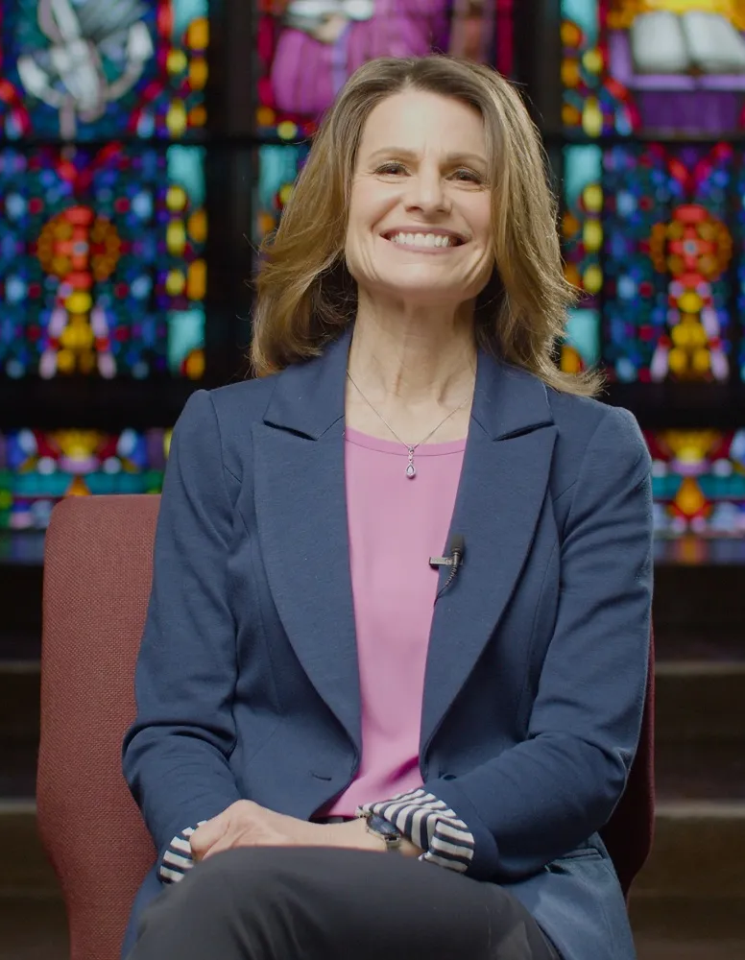
Dr. Lynn Cohick
The term “father” carried a political overtone in Paul’s day, for the emperor was known as the father of the country (pater patriae)

Slide 47
Ephesians, week 4 (pages 23–27)

Slide 48
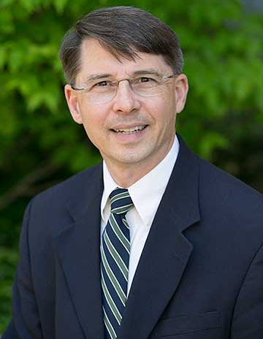
Dr. Frank Thielman
These blessings are not only from God but also from “the Lord Jesus Christ.”

Slide 49
Dr. Frank Thielman
This anticipates the way Paul, throughout Ephesians, describes Jesus as the means by which God shows the lavishness of his grace to his people.

Slide 50

From Visual Theology

Slide 51

Adapted from Visual Theology by ChatGPT

Slide 52

Dr. Bryan Chapell
This same loving God is still saying “grace and peace” to us.… When we know his grace, then we can experience his peace….

Slide 53
Dr. Bryan Chapell
With such peace the gospel conquers challenges greater than we, and grants us the confidence and compassion to face them in Christ’s name and with his blessing.

Slide 54
Next time: Ephesians 1:3–6 (pp. 27–36)

Slide 55
Commentaries
Quotes are due to Jim by Thursday night
If you would like one, let Jim know

Slide 56
Prayer time
Write down your prayer requests (on the Weekly Update or in the comments)
Lean in, engage, and pray for someone not with you
Be out of this room by 9:50
Go worship

